Slide 1
Turnitin Draft Coach

Slide 2

What is Draft Coach?
Available in Microsoft Word
Highlights text matching online sources and work submitted previously by students
Supports good academic writing and integrity
A developmental tool, not an academic misconduct judgement
Notes:
Before you submit assignments, you can use a tool called Turnitin Draft Coach.
It’s built into Microsoft Word and lets you check your work for similarity before submission.

Slide 3
How can Draft Coach help?
Avoid unintentional plagiarism
Supports review of academic writing
See where your draft matches online sources, before submitting your assignment in Blackboard
Check you’ve cited and paraphrased correctly
Reduce uncertainty around originality of your work
Notes:
Before you submit assignments, you can use a tool called Turnitin Draft Coach.
It’s built into Microsoft Word and lets you check your work for similarity before submission.
It works in Microsoft Word (online and desktop app) and lets you check your work for similarity before submission. Please read the University of Reading Draft Coach guide for full guidance.

Slide 4
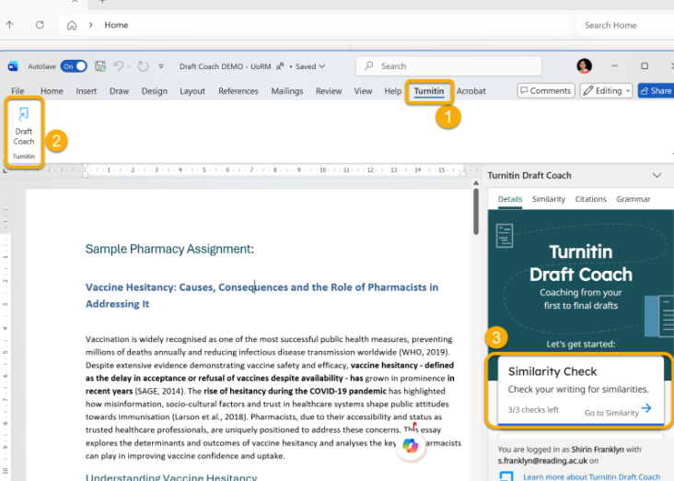
How to use Draft Coach
Open your assignment in Word
Select the Turnitin tab → Draft Coach
Run a Similarity Check
Review matched text and source information
You may run up to three similarity checks per document.
Notes:
You get three checks per document, so use them once you have a solid draft. Space out your checks to make the most out of it.

Slide 5
What Draft Coach cannot do
✖ Does not tell you if the match is plagiarised
✖ Does not correct your referencing or rewriting
✖ Grammar and citation checks are limited, so follow your programme/module guidance.
Notes:
Remember that a similarity score does not necessarily mean plagiarism. It highlights matching text, which can include things like quotations, references or common phrases. Draft Coach also includes grammar and citation checks, but these are not reliable for academic writing, so please refer to University-approved guidance for help on those.

Slide 6
Where to get help
University student guides:
Turnitin Draft Coach – Similarity Checking before Submission
How to view and interpret Turnitin Similarity Report
Library guides for academic writing and grammar.
Library ‘Citing References’ guide
Library department-specific referencing guide
If you need further guidance:
Ask your Academic Liaison Librarian
Book an appointment with a Study Advisor
Notes:
Read the University of Reading Draft Coach guide. It explains how to use the tool properly and how to understand the results.
If you’re unsure, ask for help early rather than worrying about it.

