Slide 1

Events Calendar 2025/2026

Slide 2

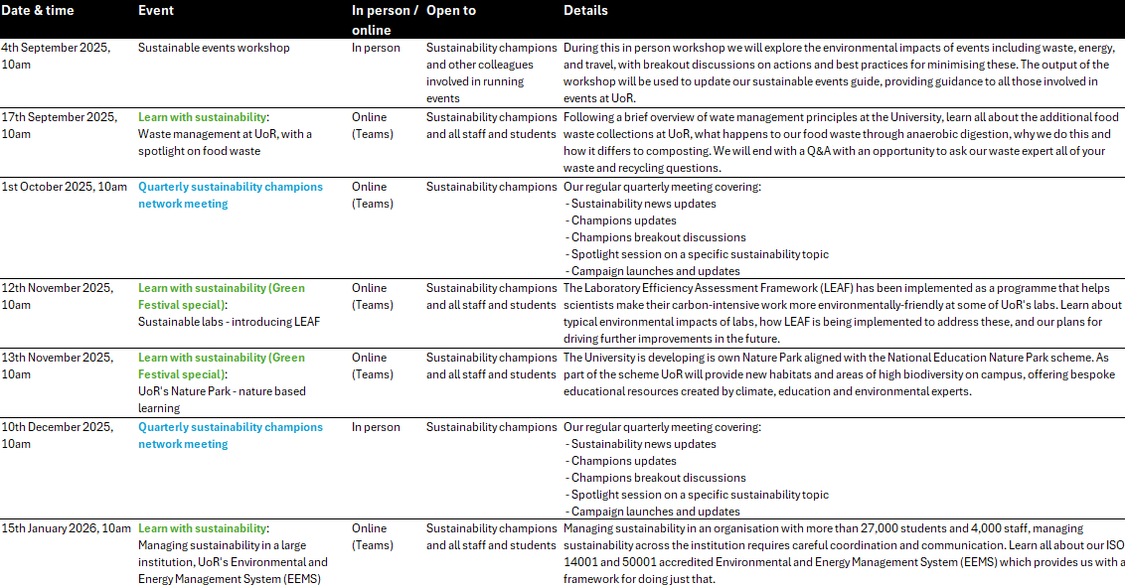
Our Future First: 2025/2026 Events Calendar - Semester 1

Slide 3
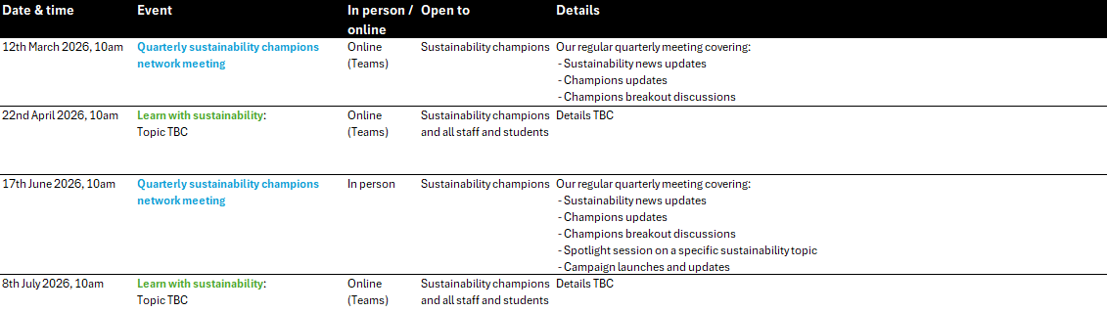
Our Future First: 2025/2026 Events Calendar - Semester 2

