Slide 1
[insert Module title here]
Using Blackboard to support your learning
Notes:
Add your module or programme title.

Slide 2
WHAT IS BLACKboard?
Blackboard Learn is the University's web-based Virtual Learning Environment (VLE)
It is used to provide you with flexible access to online learning, information and activities for your school, course and modules
You will also use it to submit assignments electronically (where appropriate)

Slide 3
How do I access Blackboard?
www.bb.reading.ac.uk
Use your University username & password
Notes:
Remind students of URL and to use their university username and password.

Slide 4
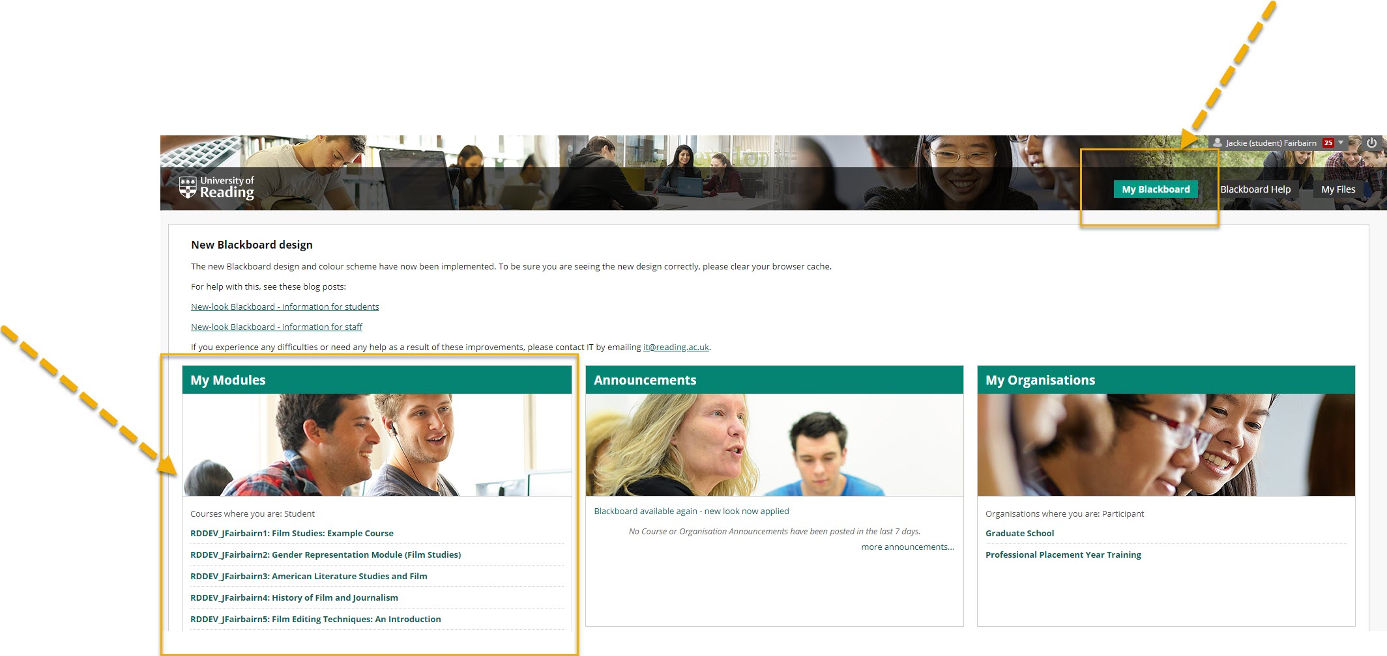
Finding my courses
Notes:
Point out key features:
Courses – where they are listed under the My Blackboard tab
Organising courses by year (first years students won’t need this yet but it would be useful for them to know) – for guidance watch this short video: http://blogs.reading.ac.uk/tel/2015/09/18/how-to-organise-your-courses-on-your-enrolments-tab-in-blackboard/
Blackboard Help tab, where they can find more guidance
It is important for the students to know that it may take a couple of days for them to be able to get access to their courses on the Enrolments tab, once their modules have been entered on their student record.

Slide 5
Guides and help
Notes:
Point out the different guides available.
Let your students know who to go to for academic queries/questions about the course and its content.
Technical queries – contact it@reading.ac.uk

Slide 6
Using Blackboard for [module name]
For this module, we will be using Blackboard for:
[delete/add as applicable]
Lecture slides (available before the lecture)
Details of your assignments
Marking criteria
Submitting your assignment online using Blackboard Assignment tool/Turnitin
Reading list
Notes:
Explain how Blackboard will be used in YOUR specific module. Delete all other options.

Slide 7
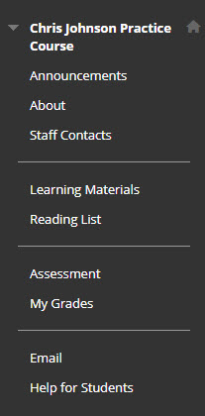
TOUR of the course
Take a look at announcements as it may include general updates about your course. You should also be able to find details about the academic staff on your course.
This is where you will find resources for your course.
Here you will find your assignments and are able to gain an overview of your grades.
If you need further help/support have a look here.
Notes:
Log in and give your students a tour of the things they will find in the course – use the list you’ve created in the previous slide.

Slide 8
Blackboard mobile app
Access learning on the go!
Keep up-to-date with announcements
Receive notifications when new content is added to your modules
Android
Google Play Store
Apple
App Store
Notes:
Students can download the Blackboard mobile app to manage their coursework, get notifications, see their results, etc. Activities can be designed for access on mobile devices, e.g. tests for access on mobiles.

