Slide 1
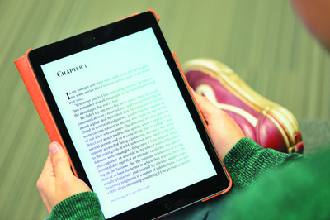
[insert Module title here]
Using Blackboard to support your learning
Notes:
Add your module or programme title.

Slide 2
WHAT IS BLACKboard?
Blackboard Learn is the University's web-based Virtual Learning Environment (VLE)
It is used to provide you with flexible access to online learning, information and activities for your school, course and modules
You will also use it to submit your coursework electronically (where appropriate)

Slide 3
How do I access Blackboard?
Use your University username & password
www.bb.reading.ac.uk
Notes:
Remind students of URL and to use their university username and password.

Slide 4
Finding my courses
Notes:
Point out key features:
Courses – where they are listed under the Enrolments tab
Organising courses by year (first years students won’t need this yet but it would be useful for them to know) – for guidance watch this short video: http://blogs.reading.ac.uk/tel/2015/09/18/how-to-organise-your-courses-on-your-enrolments-tab-in-blackboard/
Support for students tab, where they can find more guidance
It is important for the students to know that it may take a couple of days for them to be able to get access to their courses on the Enrolments tab, once their modules have been entered on their student record.

Slide 5
Guides and help
Notes:
Point out the different guides available.
Let your students know who to go to for academic queries/questions about the course and its content.
Technical queries – contact IT Support.

Slide 6
Using Blackboard for [module name]
For this module, we will be using Blackboard for:
[delete/add as applicable]
Lecture slides (available before the lecture)
Details of your assignments
Marking criteria
Submitting your assignment online using Blackboard Assignment tool/Turnitin
Reading list
Notes:
Explain how Blackboard will be used in YOUR specific module. Delete all other options.

Slide 7
TOUR of the course
Image: Bios~commonswiki, https://commons.wikimedia.org/wiki/File:Kompas_Sofia.JPG
Notes:
Log in and give your students a tour of the things they will find in the course – use the list you’ve created in the previous slide.

Slide 8
Blackboard mobile app
Access learning on the go!
Keep up-to-date with announcements
Receive notifications when new content is added to your modules
Android
Google Play Store
Apple
App Store
Notes:
Students can download the Blackboard mobile app to manage their coursework, get notifications, see their results, etc. Activities can be designed for access on mobile devices, e.g. tests for access on mobiles.

Slide 9
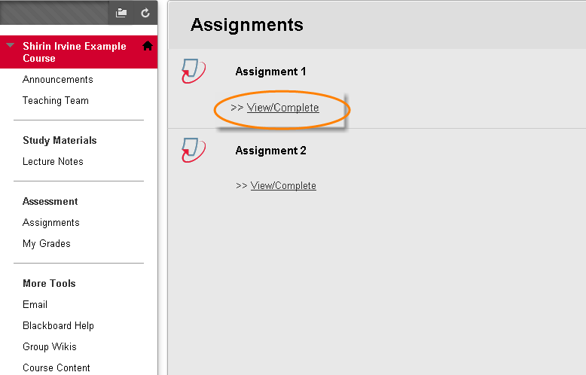
Submitting assignments online (Turnitin)
Notes:
Use the relevant slides for the type of assignment tool you use (Turnitin or Blackboard Assignmets).
Talk the students through the steps for submitting a Turnitin Assignment, using the screenshots.
NB: If you’re using Turnitin for originality checking purposes only and Blackboard Assignment for the actual assignment submission, make sure the purpose of each, due dates and instructions are AS CLEAR AS POSSIBLE for your students so they can easily distinguish between the two.
For a Turnitin submission, students go to the area on the course menu (left-hand side) where you’ve created the assignments. We advise you create a course area for assignments and label it clearly (see example shown). Once they’re in the Assignments area, they should click ‘View/complete’ under the appropriate assignment to start submission.

Slide 10
Submitting your assignment
Notes:
Once in the assignment inbox, the student will be able to see information such as assignment due date, when the inbox is available for submission (start date) and when the marks will be released (post date). To continue, click on the submit button.

Slide 11
name and title
Notes:
The student’s name will be filled in automatically and they should type in their submission title (e.g. title of their essay) – remind them of any specific instructions you may have for assignment titles in your module/department/school.

Slide 12
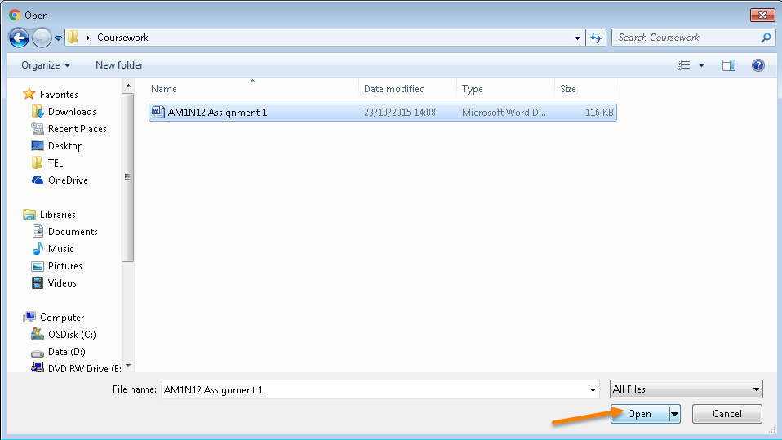
Uploading your file
Notes:
Remind the students of the disclaimer, that by submitting their assignment they agree with the statement of original authorship.
Remind them to follow the appropriate file naming conventions for your school/department before uploading their file.
They can upload files by browsing their computer, Dropbox or Google Drive, selecting the assignment file and clicking ‘open’.

Slide 13
Uploading your file
Notes:
They will then be taken to a page where they can, again, see their name and submission title, but also the attached file – remind them to check the correct file has been attached.
Click on the ‘Clear file’ button and start again if the wrong file has been attached.
Once they’ve checked the details on this page are correct, they can upload the assignment by clicking ‘Upload’.

Slide 14
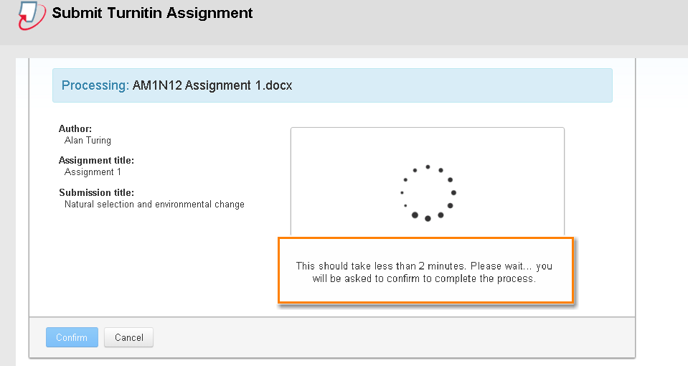
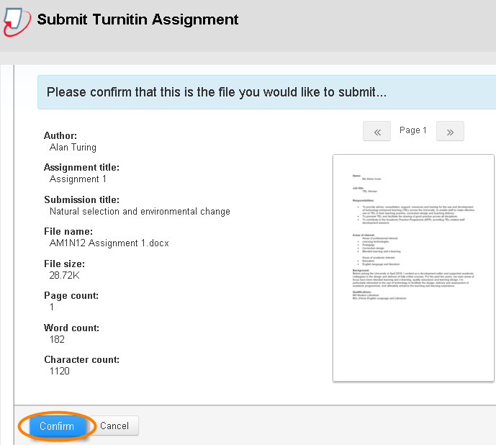
Confirming the correct file
Notes:
It may take a few minutes for the submission to process. Then students can see their file and the submission information, and can confirm submission if details are correct – otherwise they can cancel and start again.

Slide 15
How do I know my assignment has been submitted?
Digital receipt
+
Separate confirmation email to your University email account
Notes:
The green message that appears is a digital receipt, but students also receive an email to confirm their submission has been successful. This email comes with a unique paper ID that can be used for future reference.

Slide 16
Remember:
Read and follow the assignment instructions carefully
Ensure you submit Word, PowerPoint, Excel and PDF file formats
Name your file correctly according to your school/department’s file naming conventions
Avoid long file names and non-standard characters in the file name such as extra full stops, %, etc.
Check you’re submitting the correct file before completing submission
Most written work is marked anonymously, so please do not include your name anywhere in your work, or in the filename
Further help can be found on the Support for students tab
Notes:
Edit this slide according to the school/department’s policies (e.g. do you want students to include student ID in a header or as submission title?)

Slide 17
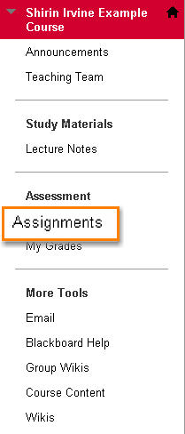
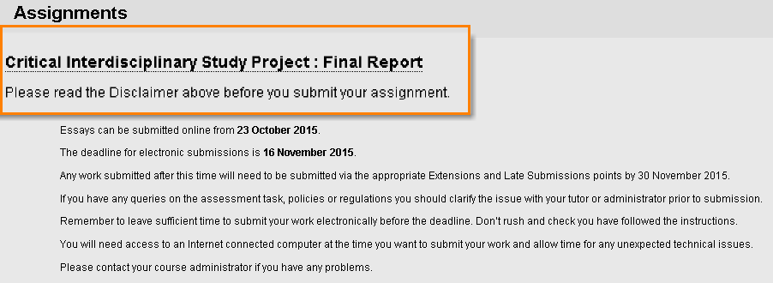
Submitting assignments online (BLACKBOARD)
Assignment Tool
Notes:
Use the relevant slides for the type of assignment tool you use (Turnitin or Blackboard Assignmets).
Talk the students through the steps for submitting a Turnitin Assignment, using the screenshots.
Explain that they should read the disclaimer (that you create as an item in the Assignments area) – statement of original authorship.
NB: If you’re using Turnitin for originality checking purposes only and Blackboard Assignment for the actual assignment submission, make sure the purpose of each, due dates and instructions are AS CLEAR AS POSSIBLE for your students so they can easily distinguish between the two.
For a Blackboard submission, students go to the area on the course menu (left-hand side) where you’ve created the assignments. We advise you create a course area for assignments and label it clearly (see example shown). Once they’re in the Assignments area, they should click on the appropriate assignment link to start submission.

Slide 18
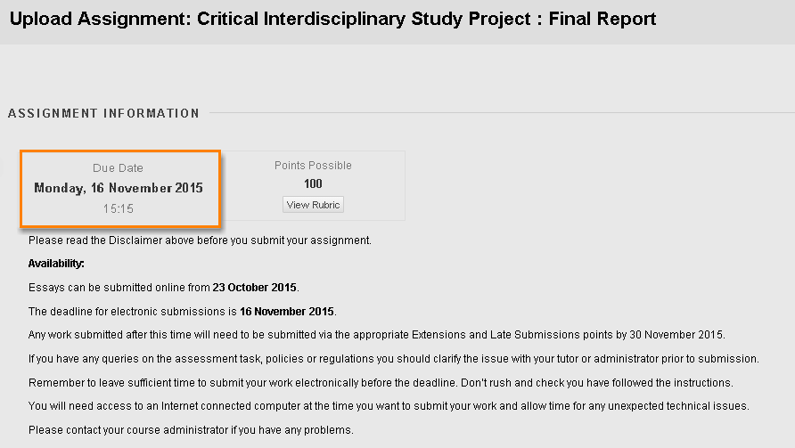
Assignment information
Assignment Tool
Notes:
Once they click on the assignment link, students can see the assignment information on the next page, followed by the assignment instructions. It might be worth advising them to read these instructions carefully again.

Slide 19
Assignment information
Assignment Tool
Notes:
Use this slide instead of the previous one if you’re marking anonymously.
[If anonymous marking has been enabled at the point of setting up the assignment, t]he students will see this note. Remind them not to include their name or other information on their assignment.

Slide 20
Uploading your file
Assignment Tool
Notes:
Remind them to follow the appropriate file naming conventions for your school/department before uploading their file.
They can upload files by browsing their computer, selecting the assignment file and clicking ‘open’.

Slide 21
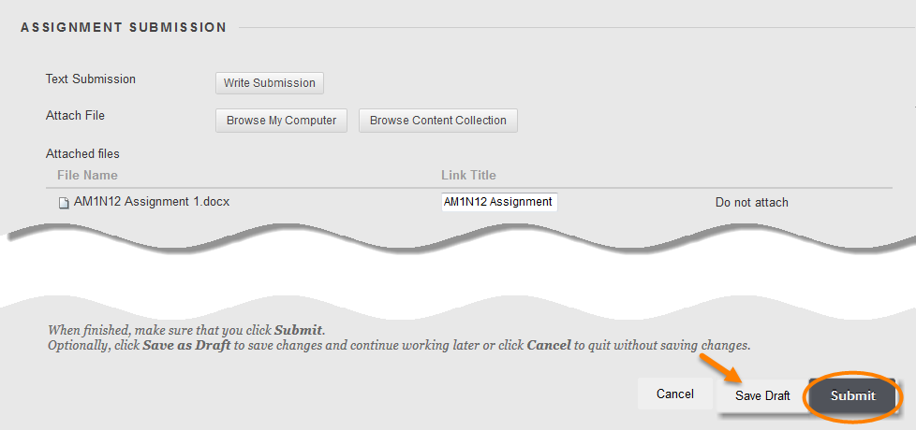
Completing the submission
Notes:
Once the file has been uploaded students can see their assignment file name and check it’s the correct one. There is the option to go back and repeat this section by clicking on ‘Do not attach’, if they’ve attached the wrong file.
Students have the option to save their work as draft as many times as they want before the submission deadline, without ‘submitting it’. Explain this and show the button next to the ‘Submit’ button. However, they must remember to complete the submission before the due date.

Slide 22
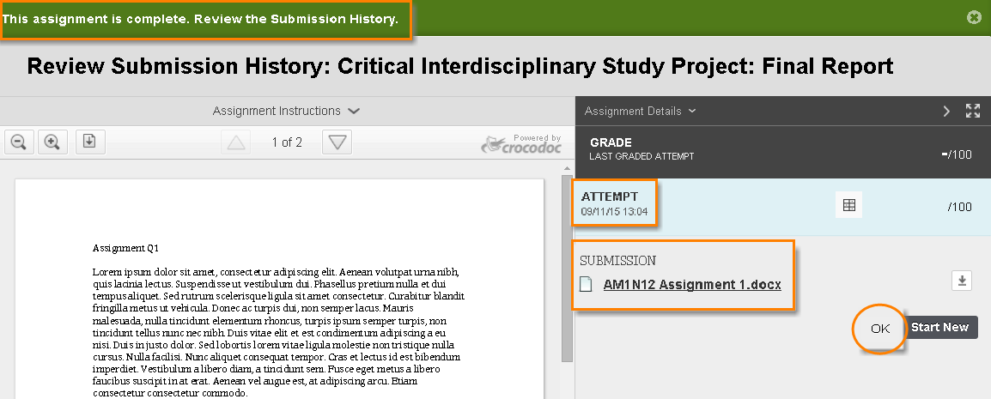
Successful submission
Assignment Tool
Notes:
The green ribbon saying ‘This assignment is complete. Review the submission history’ will appear, which means submission has been successful.
Review submission history: This page will allow the students to see they’ve submitted the correct file and they can see the assignment details (date, number of attempts, rubric if you’re using them and only if you’re making them available to the students).
It’s worth taking a screenshot of this page and saving it somewhere, as a reminder of when and at what time the assignment was submitted. The assignment link may not be available after the due date, in which case the students won’t be able to come back and see the assignment.
Let them know who to contact if they’ve submitted the wrong file by mistake.
Explain number of attempts. If you allow one attempt they can submit only once, but you may allow multiple attempts (you’ll specify the number at assignment set up stage).

Slide 23
How do I know my assignment has been submitted?
Assignment Tool
Notes:
Up until the due date, students can follow the same steps as they would for submitting the assignment to open the assignment link. They can see the submitted assignment, which is a page similar to the ‘successful submission’ page but without the green ribbon. They can see the date and time of their submission in the right-hand-side panel along with the number of attempt. In case of any issues, they can take screenshots of this page as proof of submission.
If they haven’t already done so straight after submission, remind them to take a screenshot of this page and saving it somewhere, as a reminder of when and at what time the assignment was submitted. The assignment link may not be available after the due date, in which case the students won’t be able to come back and see the assignment.

Slide 24
Remember:
Read and follow the assignment instructions carefully
Ensure you submit Word, PowerPoint, Excel and PDF file formats
Name your file correctly and according to your school/department’s file naming conventions
Avoid long file names and non-standard characters in the file name such as extra full stops, %, etc.
Ensure that you see the green ribbon informing you that the assignment is complete
After submission is complete, take a screenshot of the ‘submission history’ page and save it on your computer for future reference
Most written work is marked anonymously, so please do not include your name anywhere in your work, or in the filename
Further help can be found on the Support for students tab
Notes:
Edit this slide according to the school/department’s policies (e.g. do you want students to include student ID in a header or as submission title?)
Instruct the students on who to contact if they’ve submitted the wrong file.

