Slide 1

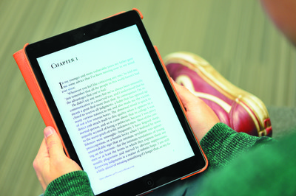

[insert Module title here]
eSubmission: Submitting your work using the Blackboard Assignment
Notes:
Add your module or programme title.

Slide 2

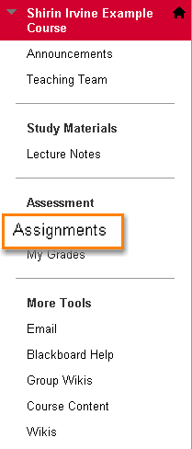
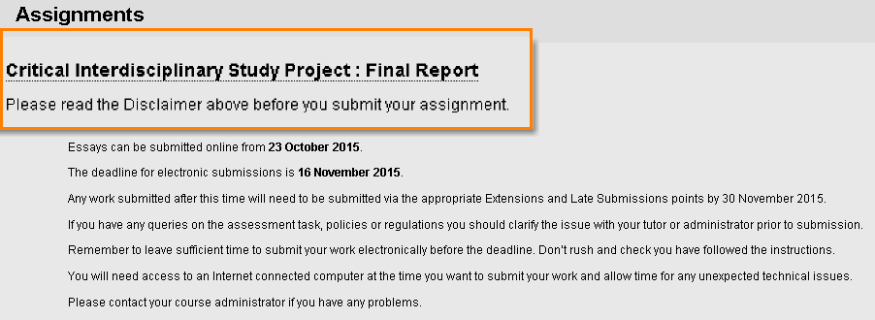
Submitting assignments online
(BLACKBOARD)
Assignment Tool
Notes:
Use the relevant slides for the type of assignment tool you use (Turnitin or Blackboard Assignmets).
Talk the students through the steps for submitting a Turnitin Assignment, using the screenshots.
Explain that they should read the disclaimer (that you create as an item in the Assignments area) – statement of original authorship.
NB: If you’re using Turnitin for originality checking purposes only and Blackboard Assignment for the actual assignment submission, make sure the purpose of each, due dates and instructions are AS CLEAR AS POSSIBLE for your students so they can easily distinguish between the two.
For a Blackboard submission, students go to the area on the course menu (left-hand side) where you’ve created the assignments. We advise you create a course area for assignments and label it clearly (see example shown). Once they’re in the Assignments area, they should click on the appropriate assignment link to start submission.

Slide 3
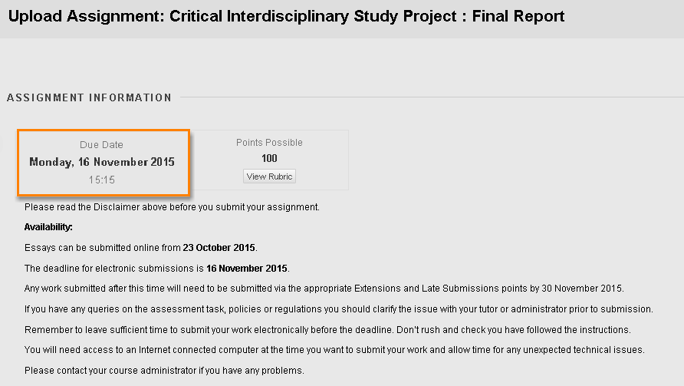
Assignment information
Assignment Tool
Notes:
Once they click on the assignment link, students can see the assignment information on the next page, followed by the assignment instructions. It might be worth advising them to read these instructions carefully again.

Slide 4
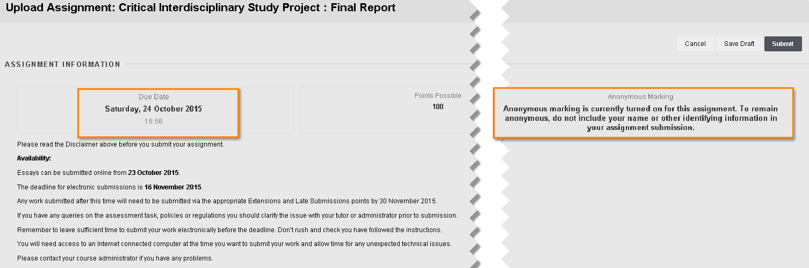
Assignment information
Assignment Tool
Notes:
Use this slide instead of the previous one if you’re marking anonymously.
[If anonymous marking has been enabled at the point of setting up the assignment, t]he students will see this note. Remind them not to include their name or other information on their assignment.

Slide 5
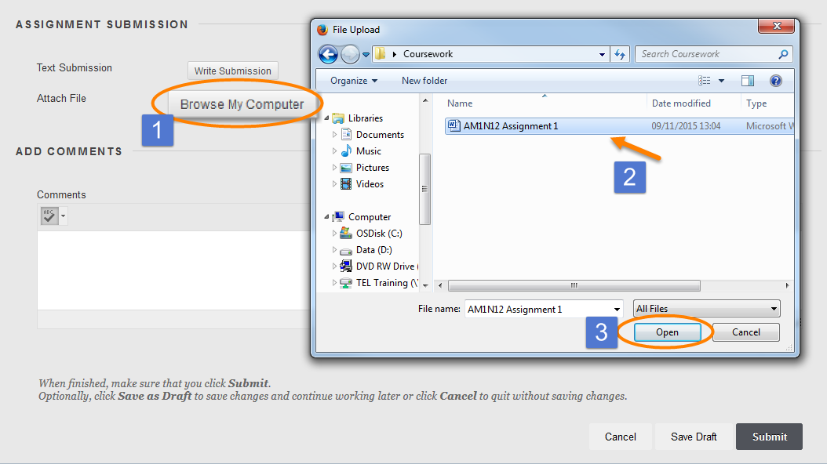
Uploading your file
Assignment Tool
Notes:
Remind them to follow the appropriate file naming conventions for your school/department before uploading their file.
They can upload files by browsing their computer, selecting the assignment file and clicking ‘open’.

Slide 6
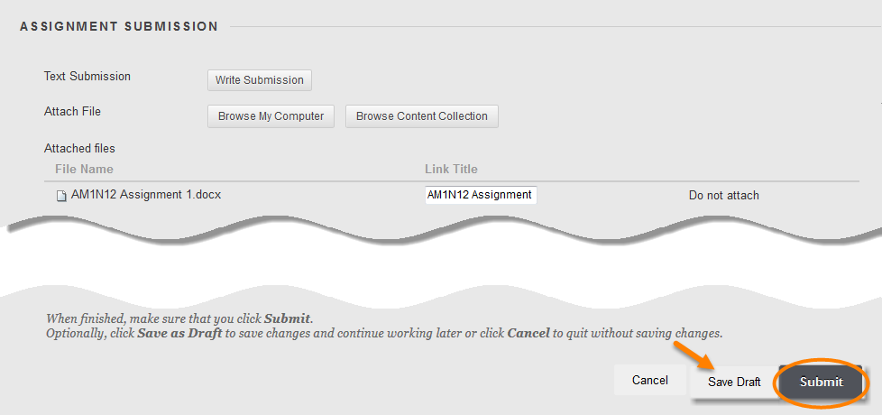
Completing the submission
Notes:
Once the file has been uploaded students can see their assignment file name and check it’s the correct one. There is the option to go back and repeat this section by clicking on ‘Do not attach’, if they’ve attached the wrong file.
Students have the option to save their work as draft as many times as they want before the submission deadline, without ‘submitting it’. Explain this and show the button next to the ‘Submit’ button. However, they must remember to complete the submission before the due date.

Slide 7
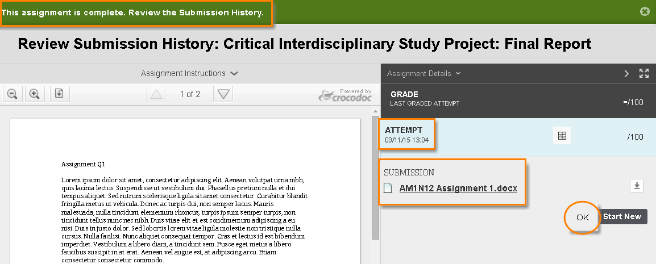
Successful submission
Assignment Tool
Notes:
The green ribbon saying ‘This assignment is complete. Review the submission history’ will appear, which means submission has been successful.
Review submission history: This page will allow the students to see they’ve submitted the correct file and they can see the assignment details (date, number of attempts, rubric if you’re using them and only if you’re making them available to the students).
It’s worth taking a screenshot of this page and saving it somewhere, as a reminder of when and at what time the assignment was submitted. The assignment link may not be available after the due date, in which case the students won’t be able to come back and see the assignment.
Let them know who to contact if they’ve submitted the wrong file by mistake.
Explain number of attempts. If you allow one attempt they can submit only once, but you may allow multiple attempts (you’ll specify the number at assignment set up stage).

Slide 8
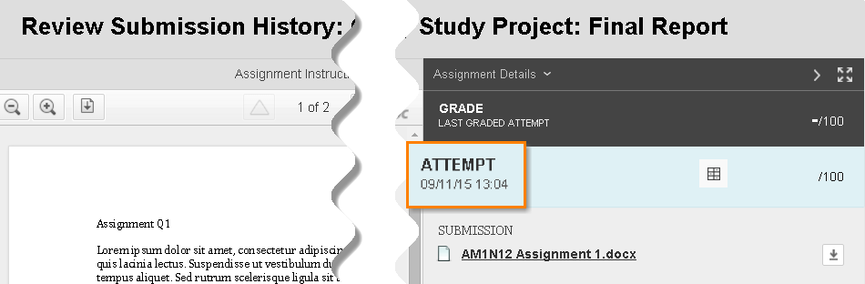
How do I know my assignment has been submitted?
Assignment Tool
Notes:
Up until the due date, students can follow the same steps as they would for submitting the assignment to open the assignment link. They can see the submitted assignment, which is a page similar to the ‘successful submission’ page but without the green ribbon. They can see the date and time of their submission in the right-hand-side panel along with the number of attempt. The assignment link may not be available after the due date, in which case the students won’t be able to come back and see the assignment.

Slide 9
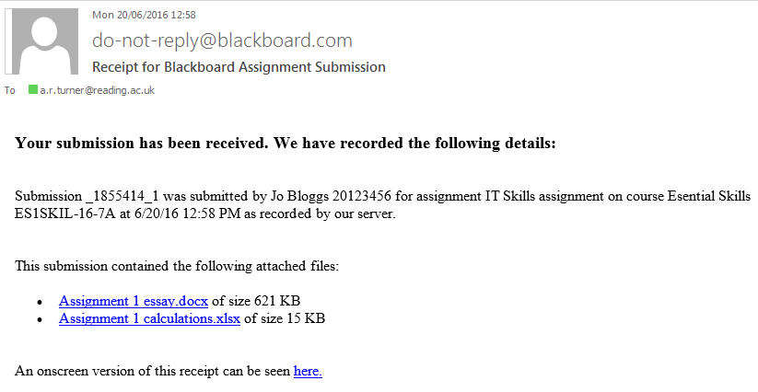
Email receipt?
Assignment Tool
In addition, you will receive an email receipt, This will be sent to your University email account, and will contain the following information:
a submission ID
your name and student number
the assignment title
the title and ID of the Blackboard course
date and time of submission
a link to the file(s) you submitted
a link to a web version of the receipt
Notes:
In addition, students will receive an email receipt, This will be sent to their University email account, and will contain the following information:
a submission ID
name and student number
the assignment title
the title and ID of the Blackboard course
date and time of submission
a link to the file(s) submitted
a link to a web version of the receipt

Slide 10
Remember:
Read and follow the assignment instructions carefully
Ensure you submit Word, PowerPoint, Excel and/or PDF file formats
Name your file correctly and according to your school/department’s file naming conventions
Avoid long file names and non-standard characters in the file name such as extra full stops, %, etc.
Ensure that you see the green ribbon informing you that the assignment is complete
Check to make sure you receive an email receipt confirming submission
Most written work is marked anonymously, so please do not include your name anywhere in your work, or in the filename
Further help can be found on the Support for students tab
Notes:
Edit this slide according to the school/department’s policies (e.g. do you want students to include student ID in a header or as submission title?)
Instruct the students on who to contact if they’ve submitted the wrong file.

