Slide 1

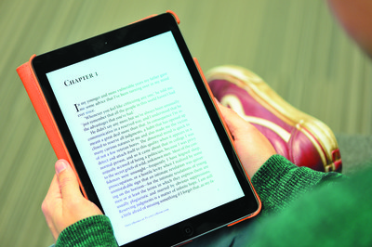

[insert Module title here]
eSubmission: Submitting your work using the Turnitin Assignment
Notes:
Add your module or programme title.

Slide 2

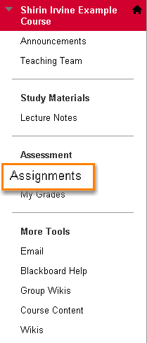
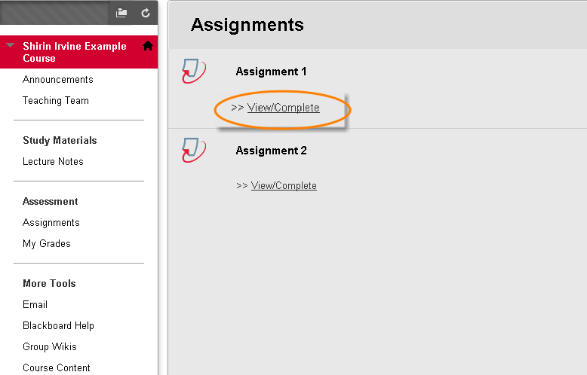
Submitting assignments online
(Turnitin)
Notes:
Use the relevant slides for the type of assignment tool you use (Turnitin or Blackboard Assignmets).
Talk the students through the steps for submitting a Turnitin Assignment, using the screenshots.
NB: If you’re using Turnitin for originality checking purposes only and Blackboard Assignment for the actual assignment submission, make sure the purpose of each, due dates and instructions are AS CLEAR AS POSSIBLE for your students so they can easily distinguish between the two.
For a Turnitin submission, students go to the area on the course menu (left-hand side) where you’ve created the assignments. We advise you create a course area for assignments and label it clearly (see example shown). Once they’re in the Assignments area, they should click ‘View/complete’ under the appropriate assignment to start submission.

Slide 3
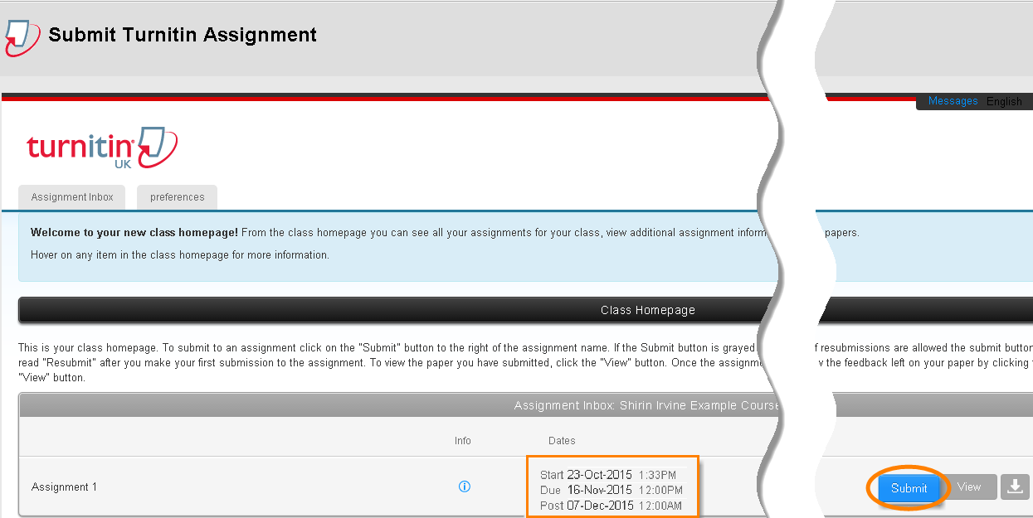
Submitting your assignment
Notes:
Once in the assignment inbox, the student will be able to see information such as assignment due date, when the inbox is available for submission (start date) and when the marks will be released (post date). To continue, click on the submit button.

Slide 4
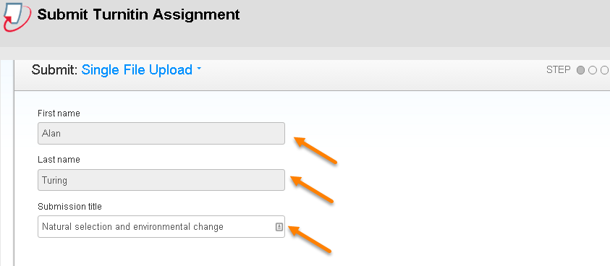
name and title
Notes:
The student’s name will be filled in automatically and they should type in their submission title (e.g. title of their essay) – remind them of any specific instructions you may have for assignment titles in your module/department/school.

Slide 5
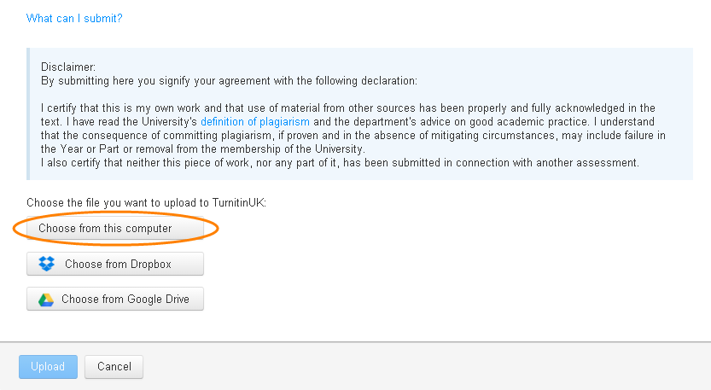
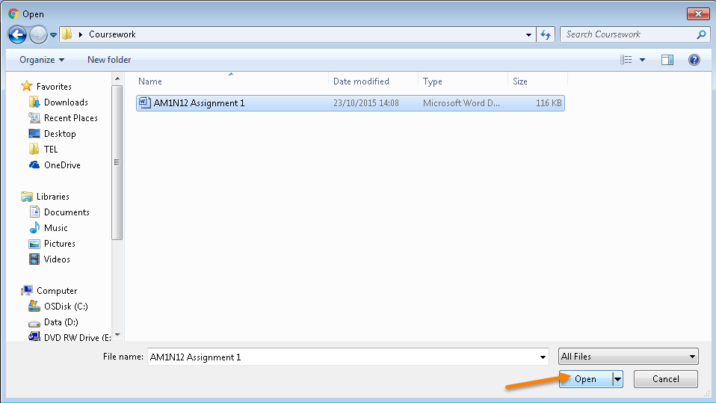
Uploading your file
Notes:
Remind the students of the disclaimer, that by submitting their assignment they agree with the statement of original authorship.
Remind them to follow the appropriate file naming conventions for your school/department before uploading their file.
They can upload files by browsing their computer, Dropbox or Google Drive, selecting the assignment file and clicking ‘open’.

Slide 6
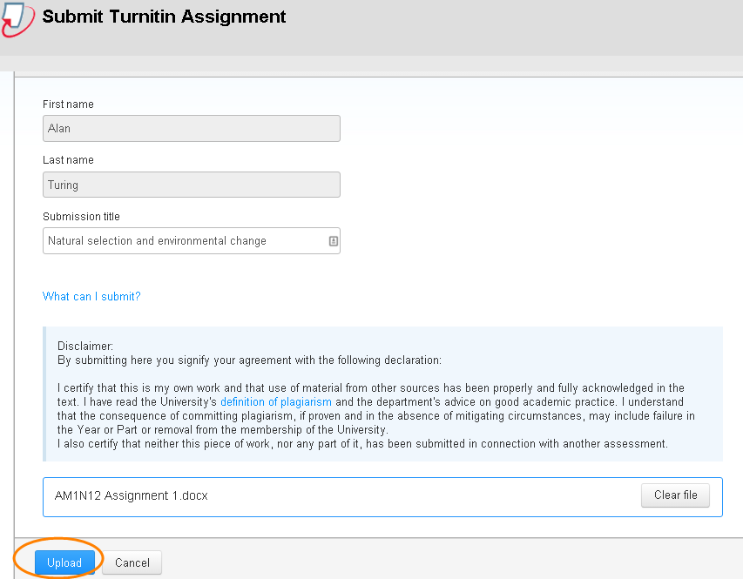
Uploading your file
Notes:
They will then be taken to a page where they can, again, see their name and submission title, but also the attached file – remind them to check the correct file has been attached.
Click on the ‘Clear file’ button and start again if the wrong file has been attached.
Once they’ve checked the details on this page are correct, they can upload the assignment by clicking ‘Upload’.

Slide 7
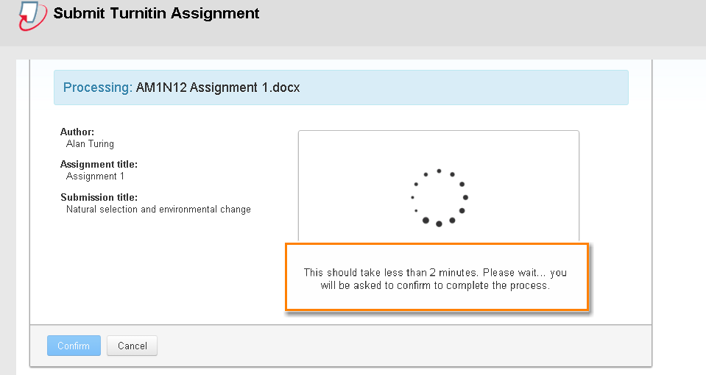
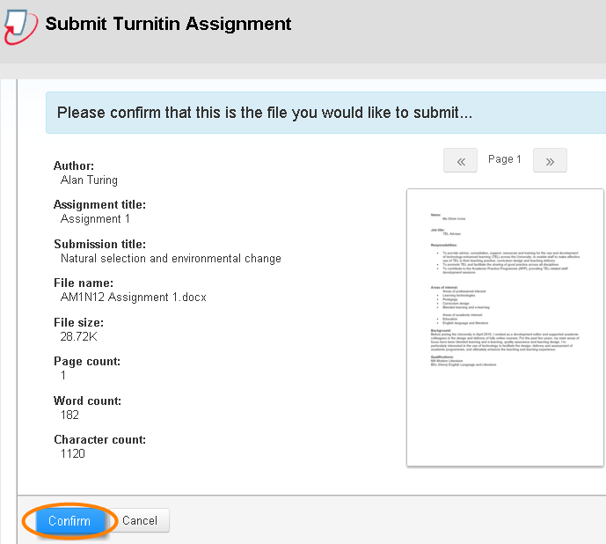
Confirming the correct file
Notes:
It may take a few minutes for the submission to process. Then students can see their file and the submission information, and can confirm submission if details are correct – otherwise they can cancel and start again.

Slide 8
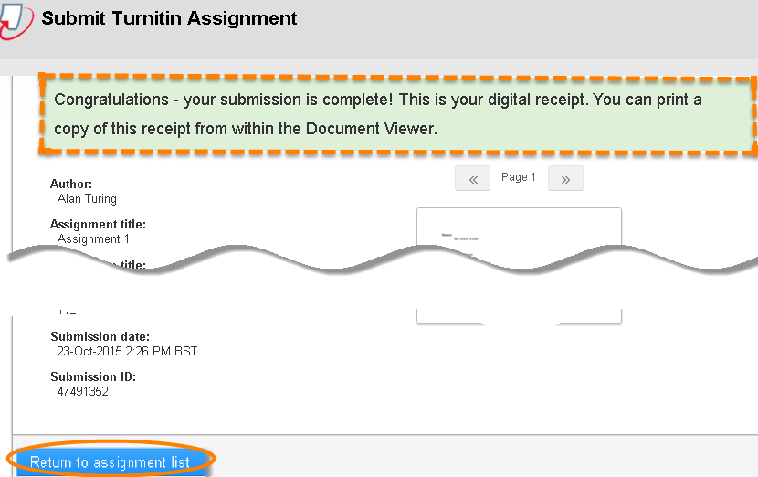
How do I know my assignment has been submitted?
Digital receipt
+
Separate confirmation email to your University email account
Notes:
The green message that appears is a digital receipt, but students also receive an email to confirm their submission has been successful. This email comes with a unique paper ID that can be used for future reference.

Slide 9

Remember:
Read and follow the assignment instructions carefully
Ensure you submit Word, PowerPoint, Excel and PDF file formats
Name your file correctly and according to your school/department’s file naming conventions
Avoid long file names and non-standard characters in the file name such as extra full stops, %, etc.
Ensure that you see the green ribbon informing you that the assignment is complete
After submission is complete, take a screenshot of the ‘submission history’ page and save it on your computer for future reference
Most written work is marked anonymously, so please do not include your name anywhere in your work, or in the filename
Further help can be found on the Support for students tab
Notes:
Edit this slide according to the school/department’s policies (e.g. do you want students to include student ID in a header or as submission title?)
Instruct the students on who to contact if they’ve submitted the wrong file.

